Slide 1
Sparkfun ESP8266 Thing-Web Server.
Eric Simmons
Chirag Padsala
Palak Lodha
Komal Musale
Jason Ligon

Slide 2
Introduction
Made a WIFI hotspot with the Sparkfun ESP8266 using the source code for the AP Web Server App on learn.sparkfun.com
Can change the LEDs using your web browser of your connected device and check the status of analog and digital pins
To program the ESP8266 a serial converter with 3.3V I/O levels is needed
Soldering is also needed to connect any other devices to the ESP8266 to give it functionality as the chip itself only has a few LEDs and WIFI capability.

Slide 3
Parts
Sparkfun ESP8266 Thing
Sparkfun FTDI Basic (serial converter)
Micro USB
USBB
2x 10-pin Stackable Headers
Break Away Male Headers- Right Angle
Reconfigured to a 6-pin Male Header

Slide 4
ESP8266 Thing
ESP8266 Thing is a breakout and development board for the ESP8266 WiFi SoC – a leading platform for Internet of Things (IoT) or WiFi-related projects.​
The Thing is low-cost and easy to use.​
The pins are broken out to two parallel, breadboard-compatible rows. USB and LiPo connectors at the top of the board provide power – controlled by the nearby ON/OFF switch. ​
LEDs towards the inside of the board indicate power, charge, and status of the IC. ​
The ESP8266’s maximum voltage is 3.6V, so the Thing has an onboard 3.3V regulator to deliver a safe, consistent voltage to the IC.​

Slide 5
ESP8266 Features
802.11 b/g/n
Wi-Fi Direct (P2P), soft-AP
Integrated TCP/IP protocol stack
Integrated TR switch, balun, LNA, power amplifier and matching network
Integrated PLLs, regulators, DCXO and power management units
+19.5dBm output power in 802.11b mode
Power down leakage current of <10uA
1MB Flash Memory
Integrated low power 32-bit CPU could be used as application processor
SDIO 1.1 / 2.0, SPI, UART
STBC, 1×1 MIMO, 2×1 MIMO
A-MPDU & A-MSDU aggregation & 0.4ms guard interval
Wake up and transmit packets in < 2ms
Standby power consumption of < 1.0mW (DTIM3)

Slide 6
Ftdi Features
Operating Voltage: 3.3V-5V
TS3USB221A Multiplexer
Switches High-Speed USB Signals

Slide 7
Ftdi Breakout
The FTDI SmartBasic hardware is pretty simple, it routes the serial signals from any board which uses the standard FTDI header footprint either to the programming PC via a USB-to-serial bridge or to any other device with a FTDI header.​
The SmartBasic board adds a multiplexer to the serial port pins coming from the Arduino, which allows the application code to switch the serial signals from the USB port to another device. ​
No special code is required to enable programming, either!​
On this board you will find two main sets of headers, CLIENT (basically the same as the output header on a standard FTDI Basic board) and HOST (which can enable the application code to route serial data from the hardware port to either the USB serial bridge or the device connected to the HOST header).​
​

Slide 8
Assembling the Hardware
To connect the FTDI programmer to your Thing you’ll need to solder something to the Thing. In Our case we used
10-pin Stackable Headers make it convenient to allow communication to the Thing through a breadboard or to connect wires or male headers
We also soldered these Headers to the Thing, for soldering you are going to no solder and an iron. Also a solder vacuum and remover is useful too as you don’t want solder to glob together.
Speaking of wires and headers, the FTDI Basic does not come with wires or headers. We used
Breakaway right-angle male header which are breakable male headers that can be broken into smaller headers, such as
6-pin right-angle male header allowed us to interface between the FTDI and the Thing.

Slide 9
Arduino IDE​
​
The Arduino Integrated Development Environment - or Arduino Software (IDE) - contains a text editor for writing code, a message area, a text console, a toolbar with buttons for common functions and a series of menus. ​
It connects to the Arduino and Genuino hardware to upload programs and communicate with them.​
Programs written using Arduino Software (IDE) are called sketches.​
These sketches are written in the text editor and are saved with the file extension .ino. The editor has features for cutting/pasting and for searching/replacing text. ​
The message area gives feedback while saving and exporting and also displays errors. The console displays text output by the Arduino Software (IDE), including complete error messages and other information.​
The bottom righthand corner of the window displays the configured board and serial port. The toolbar buttons allow you to verify and upload programs, create, open, and save sketches, and open the serial monitor.​

Slide 10
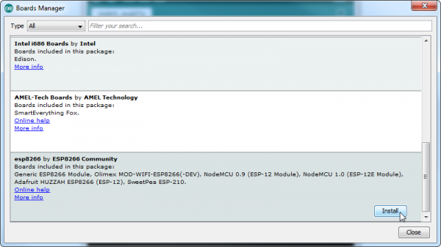
Using Arduino with the ESP8266 Thing
First you need to update the board manager, here we used the board manager package found at http://arduino.esp8266.com/stable/package_esp8266com_index.json
Next you need to navigate to the board manager and install the ESP8266 addon. You can do this by going to Tools > Board Manager

Slide 11
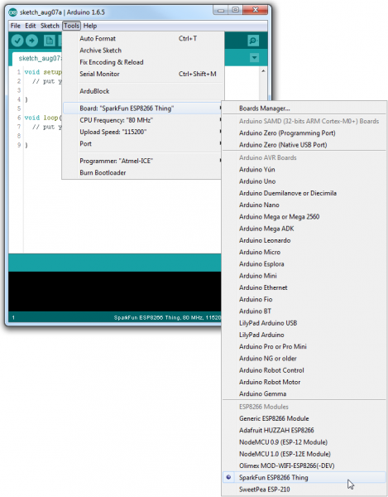
Using Arduino with the ESP8266 Thing cont.
After installing the addon you need to go to tools and select your board as the Spark ESP8266 Thing. You can do this by going to Tools > Board > SparkFUN ESP8266 Thing
Select your board’s port number and under tools > port
You are ready to program

Slide 12
Coding the Thing
While you could start from scratch Sparkfun provides many open sourced sample projects to help get started up
Some examples they provide other than AP Web Server
Blink (turn on LED)
Posting to Phant (post to their online data-storage)
Goodnight Thing (puts the Thing into sleep mode)
You can find more at https://learn.sparkfun.com/tutorials/esp8266-thing-hookup-guide/example-sketch-posting-to-phant

Slide 13
Exploring the Code
////////////////////// // WiFi Definitions // ////////////////////// const char WiFiAPPSK[] = "sparkfun"; ///////////////////// // Pin Definitions // ///////////////////// const int LED_PIN = 5; // Thing's onboard, green LED const int ANALOG_PIN = A0; // The only analog pin on the Thing const int DIGITAL_PIN = 12; // Digital pin to be read WiFiServer server(80); void setup() { initHardware(); setupWiFi(); server.begin(); }
The code is quite long, but there are some interesting bits we can change which changes how the program works.
Such as one of the first things if you look at the code is const char WiFiAPPSK[] = "sparkfun";
We can change the password from sparkfun to anything else with this

Slide 14
Exploring the Code Continued
Looking at the pin definitions we can change which LED lights up the default is 5 which is the things green LED
///////////////////// // Pin Definitions // ///////////////////// const int LED_PIN = 5; // Thing's onboard, green LED const int ANALOG_PIN = A0; // The only analog pin on the Thing const int DIGITAL_PIN = 12; // Digital pin to be read WiFiServer server(80); void setup() { initHardware(); setupWiFi(); server.begin(); }

Slide 15
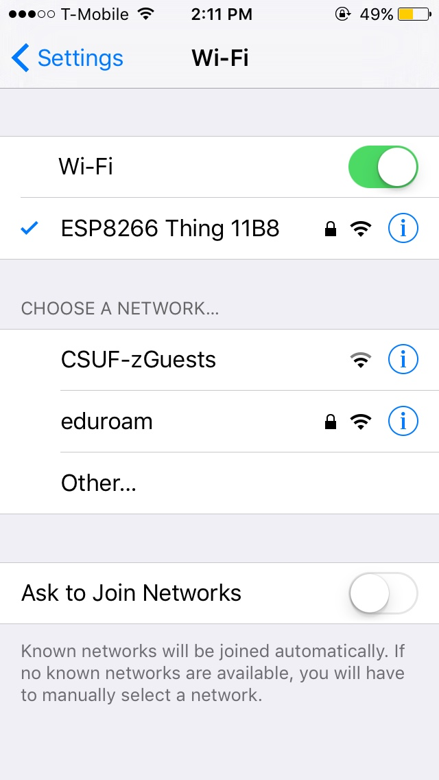
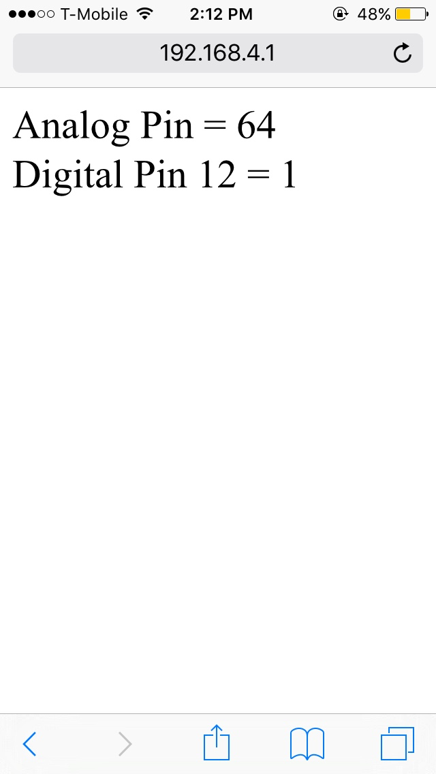
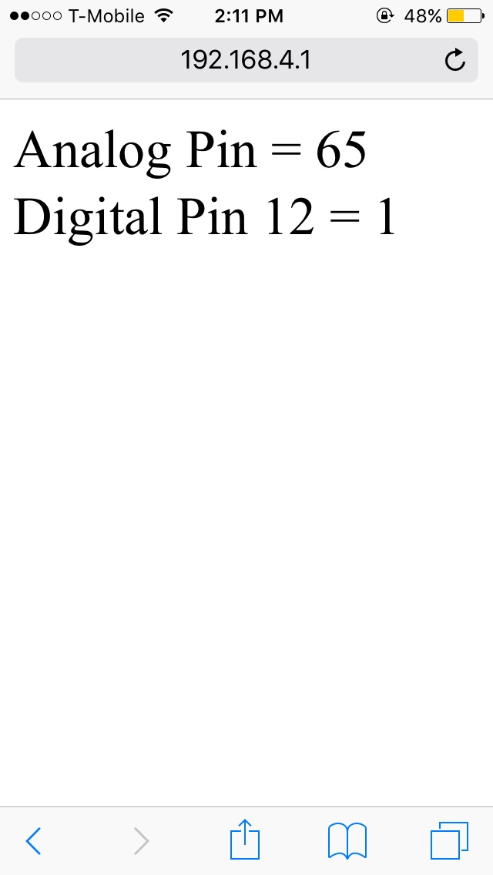
Demonstration

Slide 16
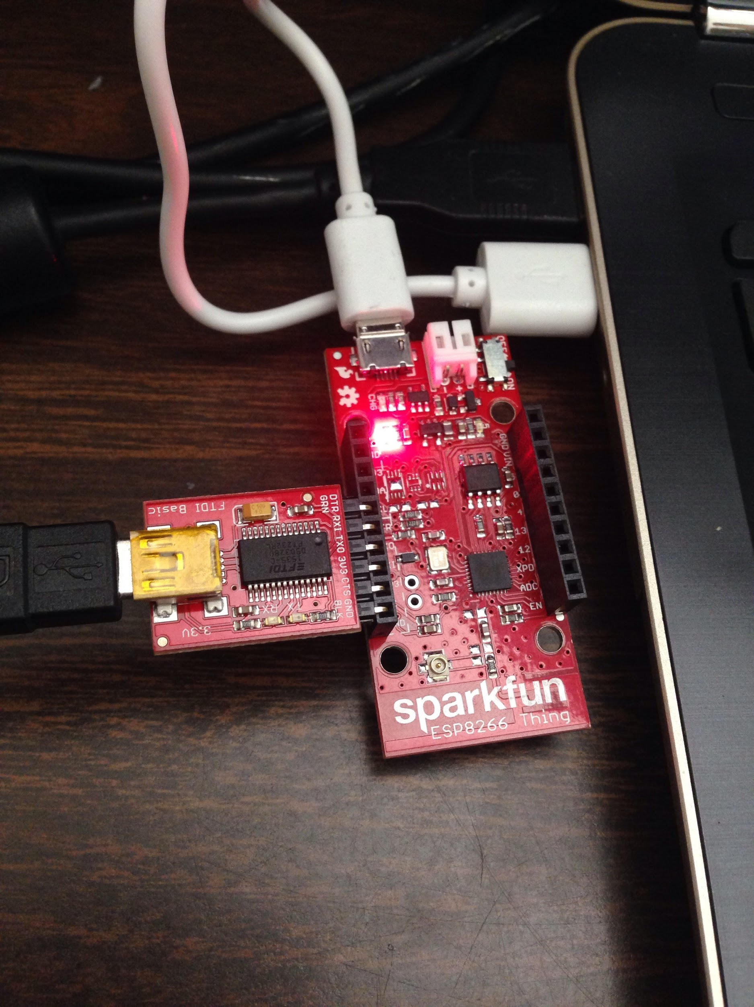
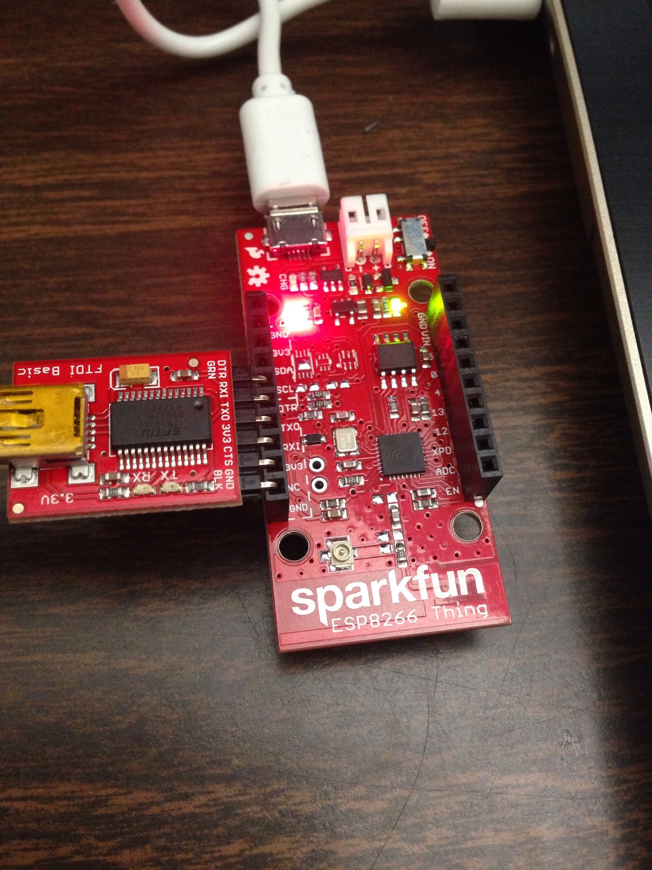
Demonstration

Slide 17
References
https://learn.sparkfun.com/tutorials/esp8266-thing-hookup-guide/example-sketch-ap-web-server
https://learn.sparkfun.com/tutorials/esp8266-thing-hookup-guide?_ga=1.2240115.256908981.1475790501
https://learn.sparkfun.com/tutorials/esp8266-thing-hookup-guide/hardware-assembly
https://learn.sparkfun.com/tutorials/esp8266-thing-hookup-guide/installing-the-esp8266-arduino-addon
https://learn.sparkfun.com/tutorials/esp8266-thing-hookup-guide/example-sketch-posting-to-phant
https://learn.sparkfun.com/tutorials/esp8266-thing-hookup-guide/powering-the-thing
https://learn.sparkfun.com/tutorials/esp8266-thing-hookup-guide/programming-the-thing
https://www.sparkfun.com/products/13231
https://en.wikipedia.org/wiki/ESP8266

Slide 18
Demonstration Video

Slide 19
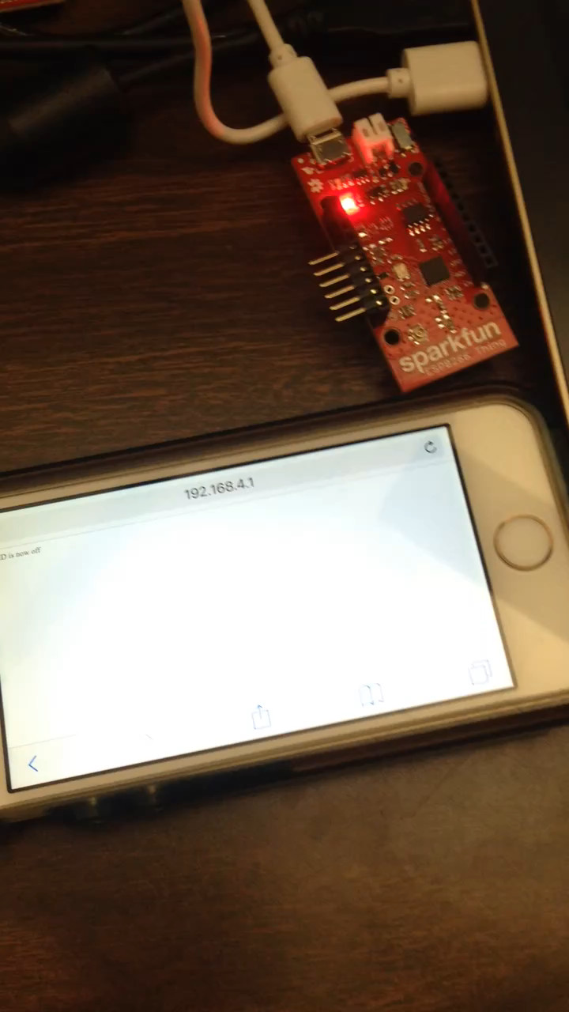

Slide 20
Thank You!

